Slide 1
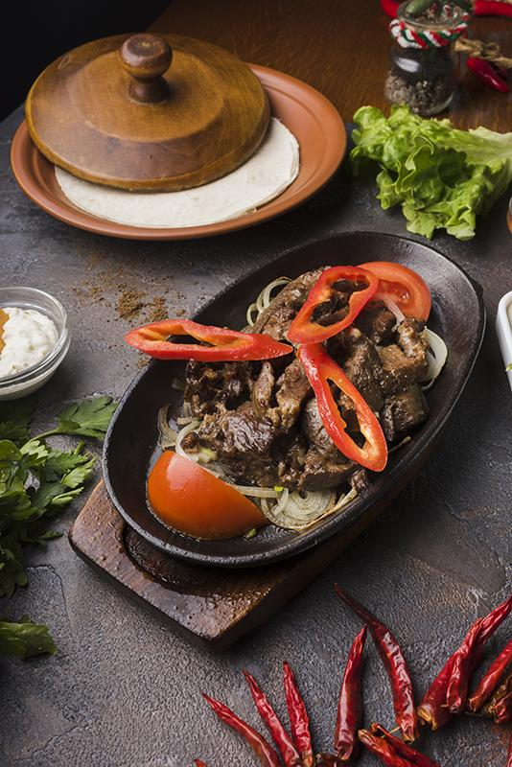
RESTAURANT REVENUE PREDICTION
Using Machine Learning

Slide 2
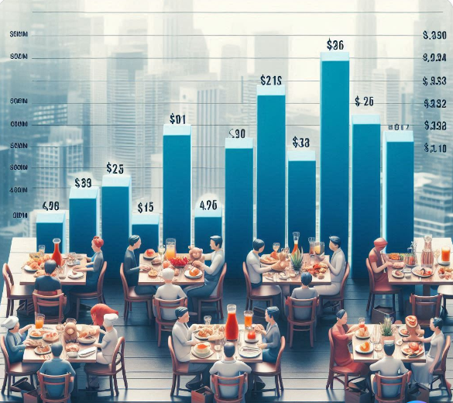
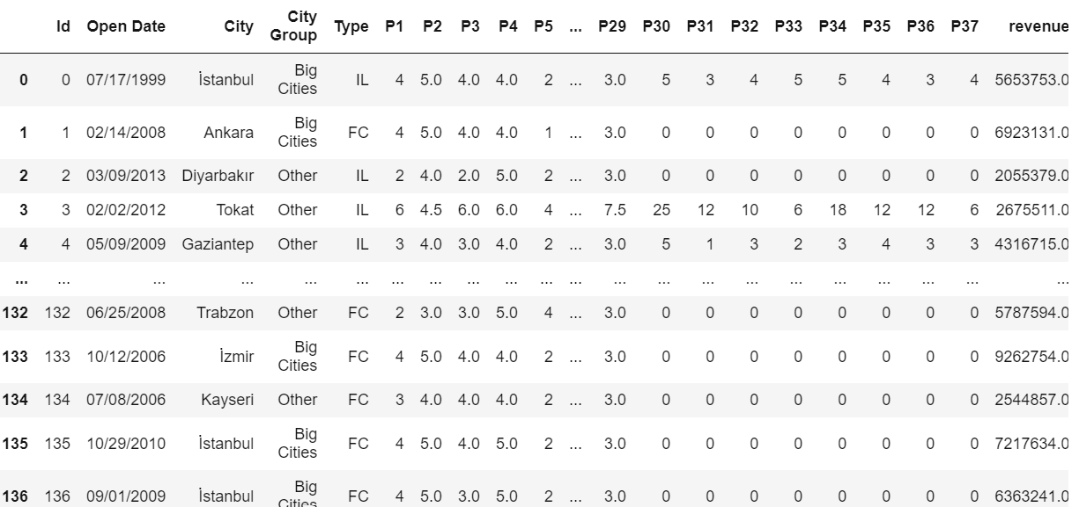
INTRODUCTION
This project aims to predict restaurant revenue.
Accurately predicting restaurant revenues can help in financial planning and investment decisions.
Helps in identifying potential high-revenue locations and restaurant types for new openings.
- Number of Restaurants: 137 in training set, 100,000 in test set
Split: 80% training set, 20% testing set
- Columns:
- Id: Restaurant identifier
- Open Date: Date the restaurant opened
- City: City where the restaurant is located
- City Group: Classification of cities (Big Cities, Other)
- Type: Type of restaurant (FC: Food Court, IL: Inline, DT: Drive Thru)
- P1 to P37: 37 obfuscated features (Demographic, Real Estate, Commercial)
- Revenue: Transformed revenue (target variable)

Slide 3
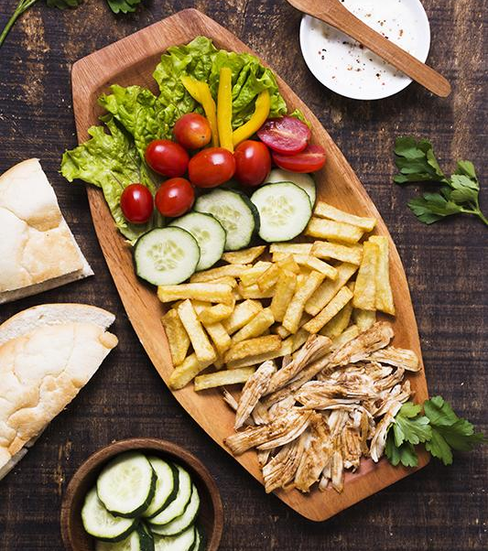
WORKFLOW
Data Exploration
Preparation
Model Training
Feature Engineering
Hyperparameter tuning to create accurate predictive models.

Slide 4
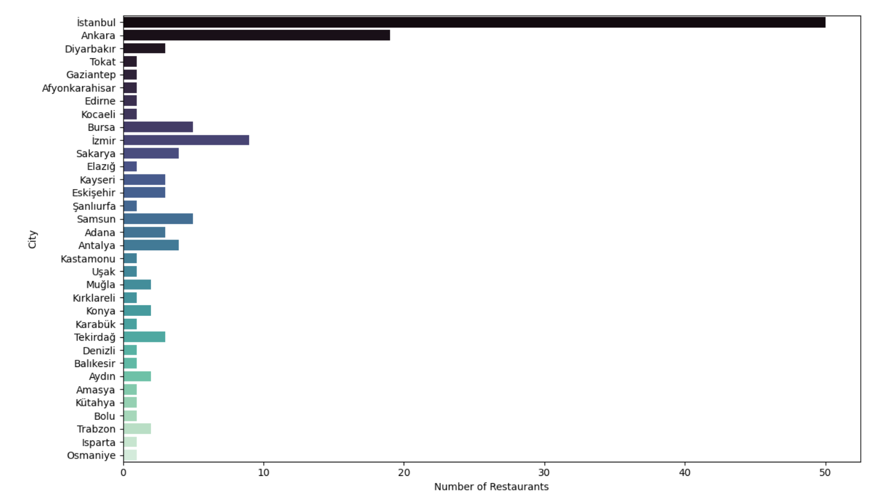
The bar chart provides a visual representation of the number of restaurants in various cities.
City Distribution:
Istanbul has the highest number of restaurants, followed by Ankara and Diyarbakır.
Other cities like Tokat, Gaziantep, and Afyonkarahisar also have a significant presence.

Slide 5
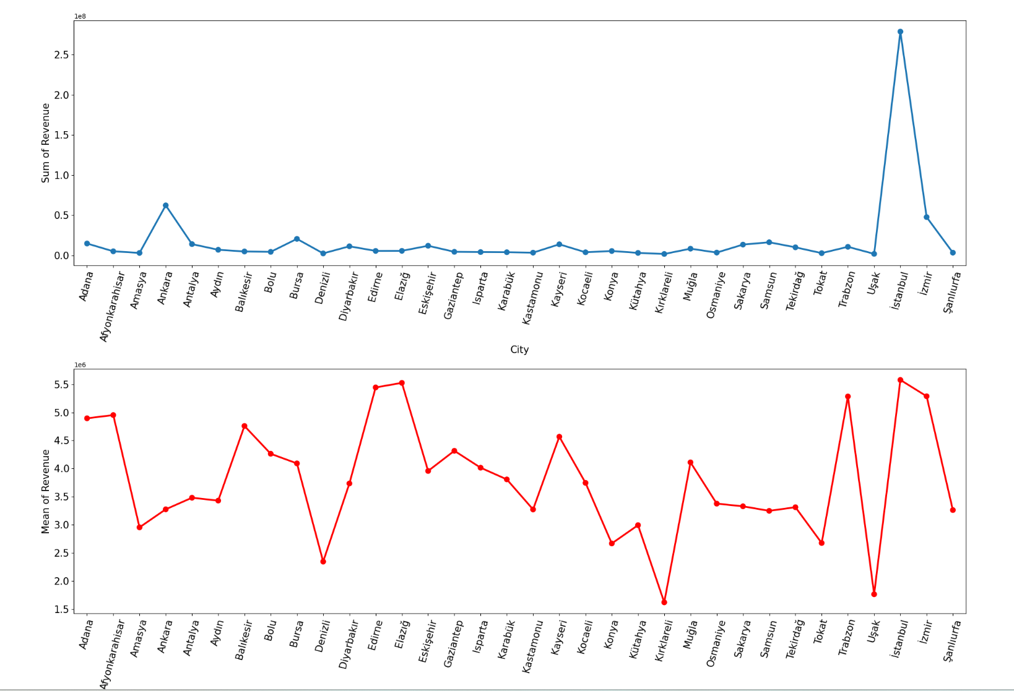
The point plots provide insights into the revenue distribution across different cities.
Sum of Revenue by City:
Istanbul has the highest total revenue, followed by Ankara and Antalya.
Other cities like Adana, Gaziantep, and Bursa also contribute significantly.
Mean of Revenue by City:
While Istanbul still has a high mean revenue, smaller cities like Muğla and Kocaeli also perform well.
This metric helps us understand the profitability of individual restaurants within each city.
Insertyour logo

Slide 6
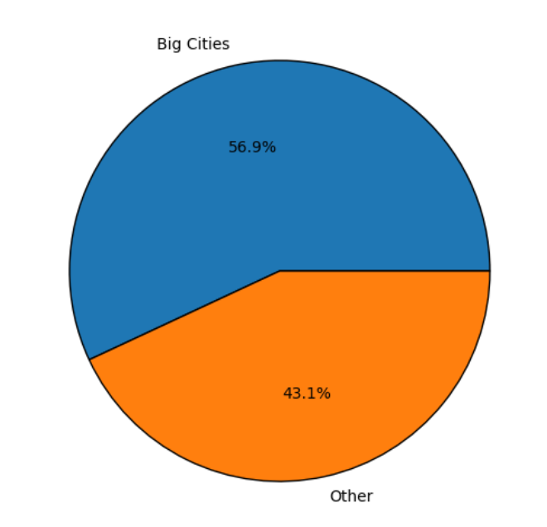
The pie chart provides a visual representation of the distribution of restaurants based on their city groups.
Big Cities:
The blue segment represents restaurants located in big cities.
These cities have a larger share of the restaurant dataset.
Other Cities:
The orange segment represents restaurants in other cities (outside the big cities category).
Although smaller in proportion, these cities still contribute significantly.

Slide 7
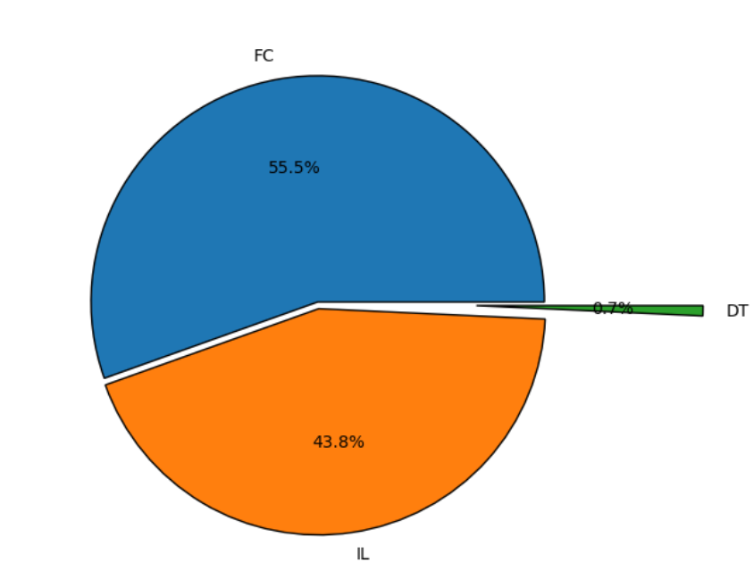
Distribution of Restaurant Types:
- Food Court (FC) most common,
- Drive Thru (DT)
- Inline (IL)
- Revenue Insights:
- Highest total and mean revenue for Food Court (FC) restaurants.

Slide 8
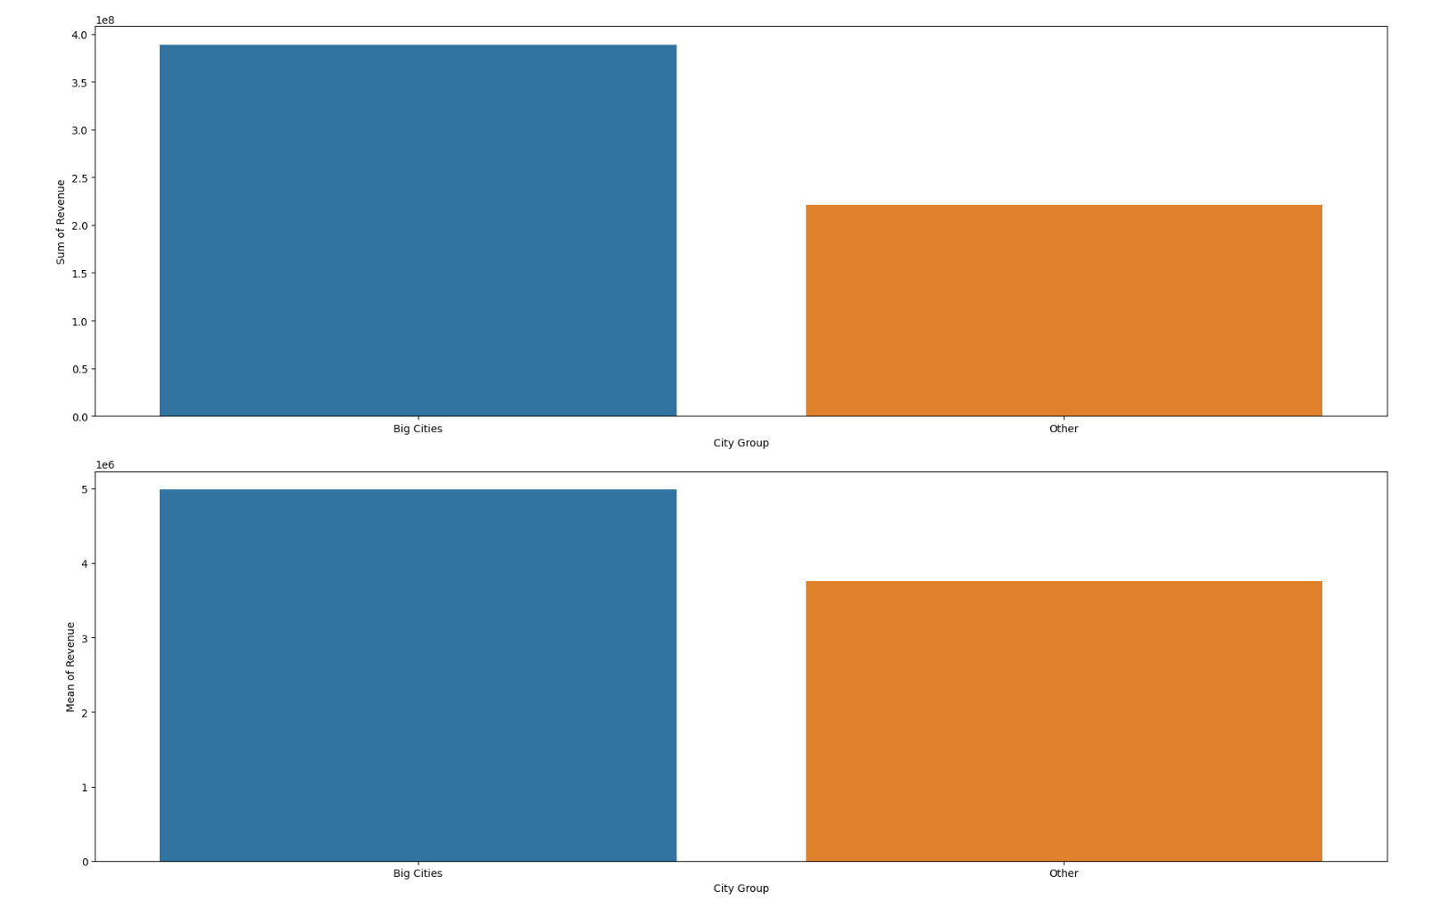
The bar charts provide insights into the revenue distribution across different city groups.
Sum of Revenue by City Group:
“Big Cities” contribute significantly more to the overall revenue compared to the “Other” category.
Mean of Revenue by City Group:
While “Big Cities” still have a higher mean revenue, the “Other” category also performs well.
Revenue Insights:
- Higher total and mean revenue in Big Cities

Slide 9
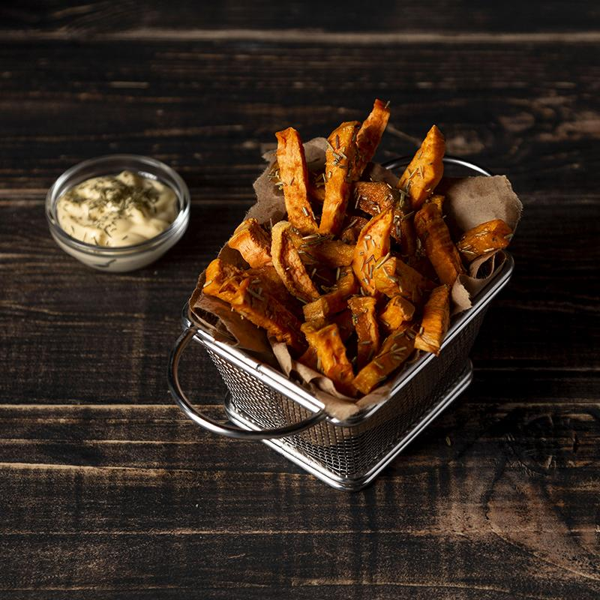
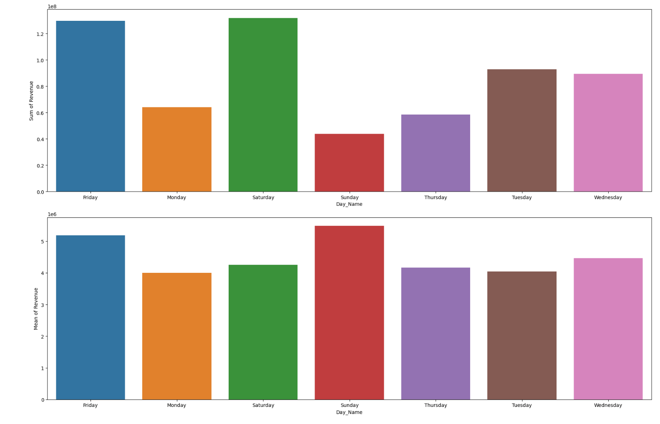
Sum of Revenue by Day:
The top chart represents the total revenue generated by restaurants on each day.
Saturday and Friday have the highest sum of revenue, followed by Thursday and Sunday.
Mean of Revenue by Day:
The bottom chart displays the average revenue per restaurant for each day.
Saturday and Friday still have higher mean revenues, while Sunday and Monday also perform well.

Slide 10
OUR LOCATIONS
City Distribution Insights
Highest number in Istanbul, followed by Ankara and Diyarbakır
- Market Analysis:
- Big cities attract more restaurants
- Untapped markets in cities like Tokat, Gaziantep
Revenue Distribution Insights
- Sum and Mean of Revenue by City:
- Istanbul highest in both total and mean revenue
- Smaller cities like Muğla and Kocaeli perform well in mean revenue

Slide 11

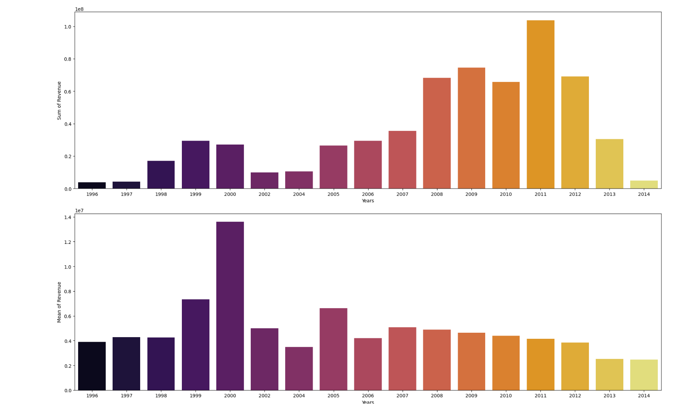
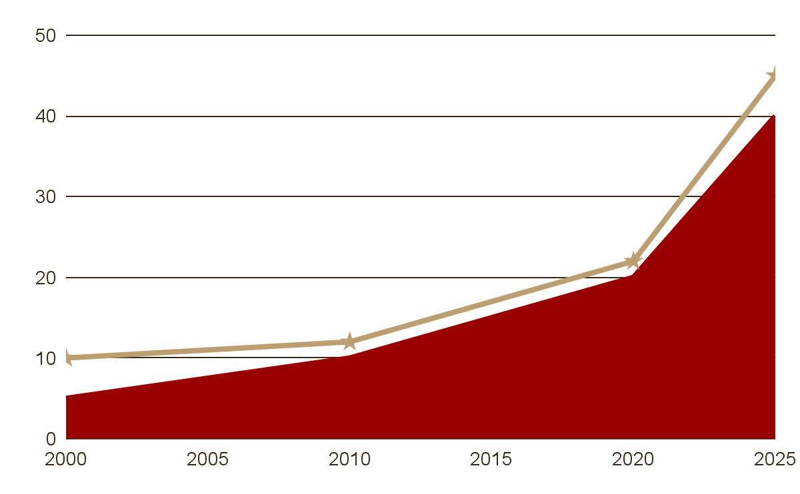
Yearly Trends
- Number of Restaurants:
- Increasing trend over time
- Peaks in 2002 and 2014
- Revenue Trends:
- Increasing total and mean revenue over the years

Slide 12
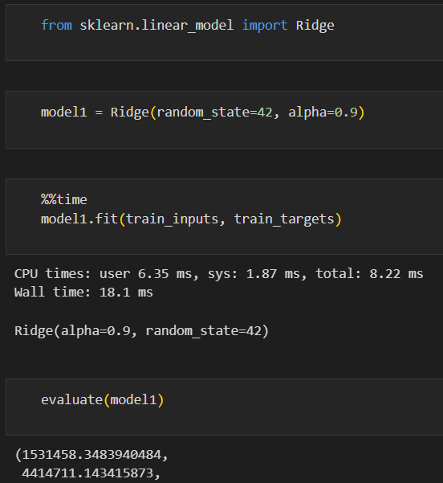

Models Evaluated
Linear Regression (Ridge)
Model Performance Details
Ridge Regression
Training RMSE: 1,531,458.35
Validation RMSE: 4,414,711.14
Ridge regression, which is a type of linear regression with L2 regularization, shows a significant difference between the training and validation RMSE. The relatively lower training RMSE indicates that the model fits the training data quite well, but the high validation RMSE suggests it does not generalize well to unseen data. This might be due to underfitting, where the model is too simple to capture the underlying patterns in the data.

Slide 13
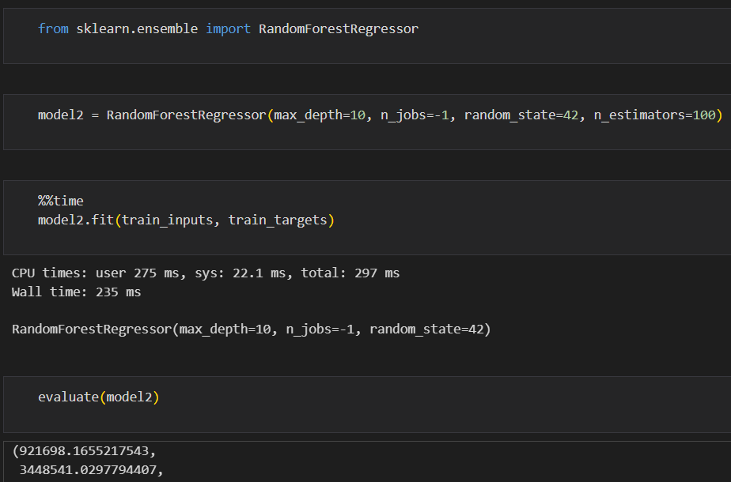

Models Evaluated
Random Forest
Training RMSE: 921,698.17
Validation RMSE: 3,448,541.03
The Random Forest model, an ensemble method that uses multiple decision trees, shows a lower training RMSE compared to Ridge Regression, indicating a better fit on the training data. The validation RMSE is also lower than that of Ridge Regression, suggesting that the model generalizes better to the validation data. However, the gap between training and validation RMSE indicates some overfitting, where the model is too complex and captures noise along with the underlying patterns.

Slide 14
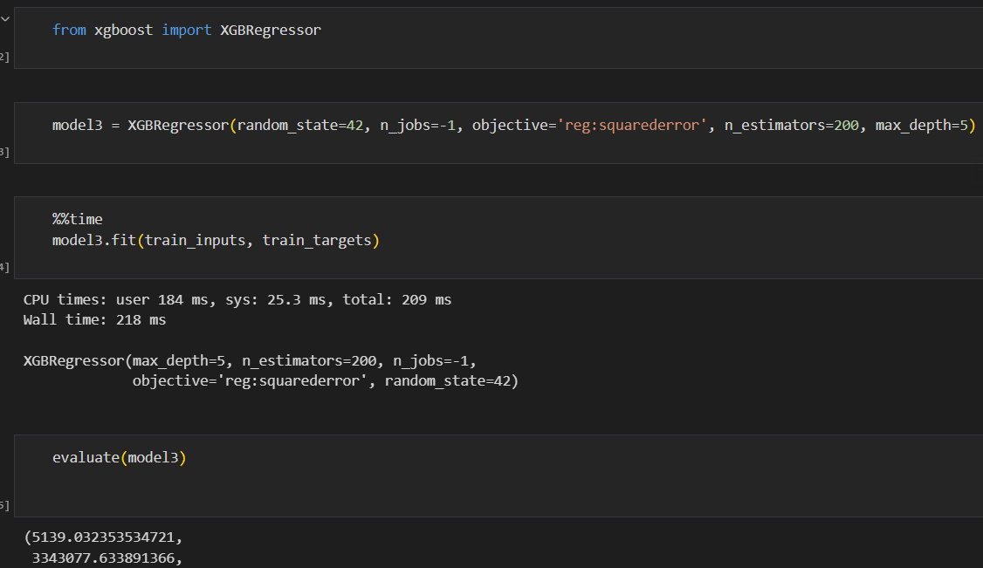

Models Evaluated
Gradient Boosting
Training RMSE: 5,139.03
Validation RMSE: 3,343,077.63
Gradient Boosting, another ensemble method but with sequential tree-building, has the lowest training RMSE, showing an excellent fit on the training data. Its validation RMSE is also the lowest among the three models, indicating the best generalization performance. The extremely low training RMSE suggests that the model is very complex, which might overfit the training data, but it still performs the best on the validation set.

Slide 15
Model Performance Comparison
Based on the validation RMSE values:
Gradient Boosting is the best-performing model with a validation RMSE of 3,343,077.63.
Random Forest comes next with a validation RMSE of 3,448,541.03.
Ridge Regression performs the worst with a validation RMSE of 4,414,711.14.
Gradient Boosting is the optimal choice among the models evaluated for predicting the target variable with the given dataset, as it shows the best balance between fitting the training data and generalizing to new data.

Slide 16
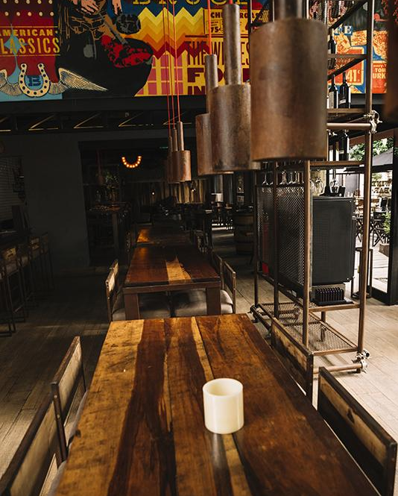
Conclusion
Predictive analysis of restaurant revenues provides valuable insights for strategic decision-making.
Combining data-driven insights with business acumen helps optimize operations, enhance profitability, and drive growth in the competitive restaurant industry.
Market Analysis:
Understanding the revenue patterns across different cities, city groups, and restaurant types aids in market segmentation.
Allows businesses to tailor their strategies to different market conditions and customer preferences.

Slide 17
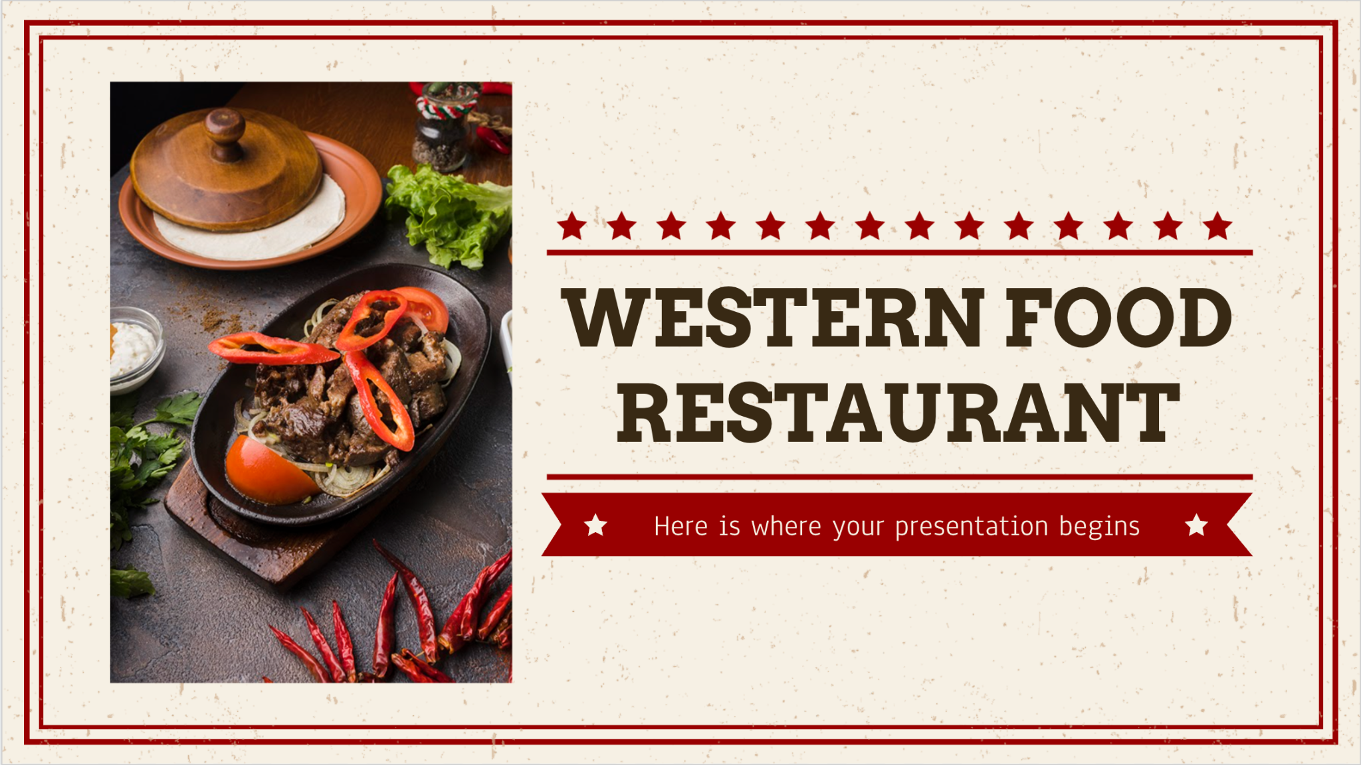
THANKS!
Presented by,
Abdul Quader Mohammed
Deepti More
Sudharsan Tirumal
Insert you image

